Slide 1
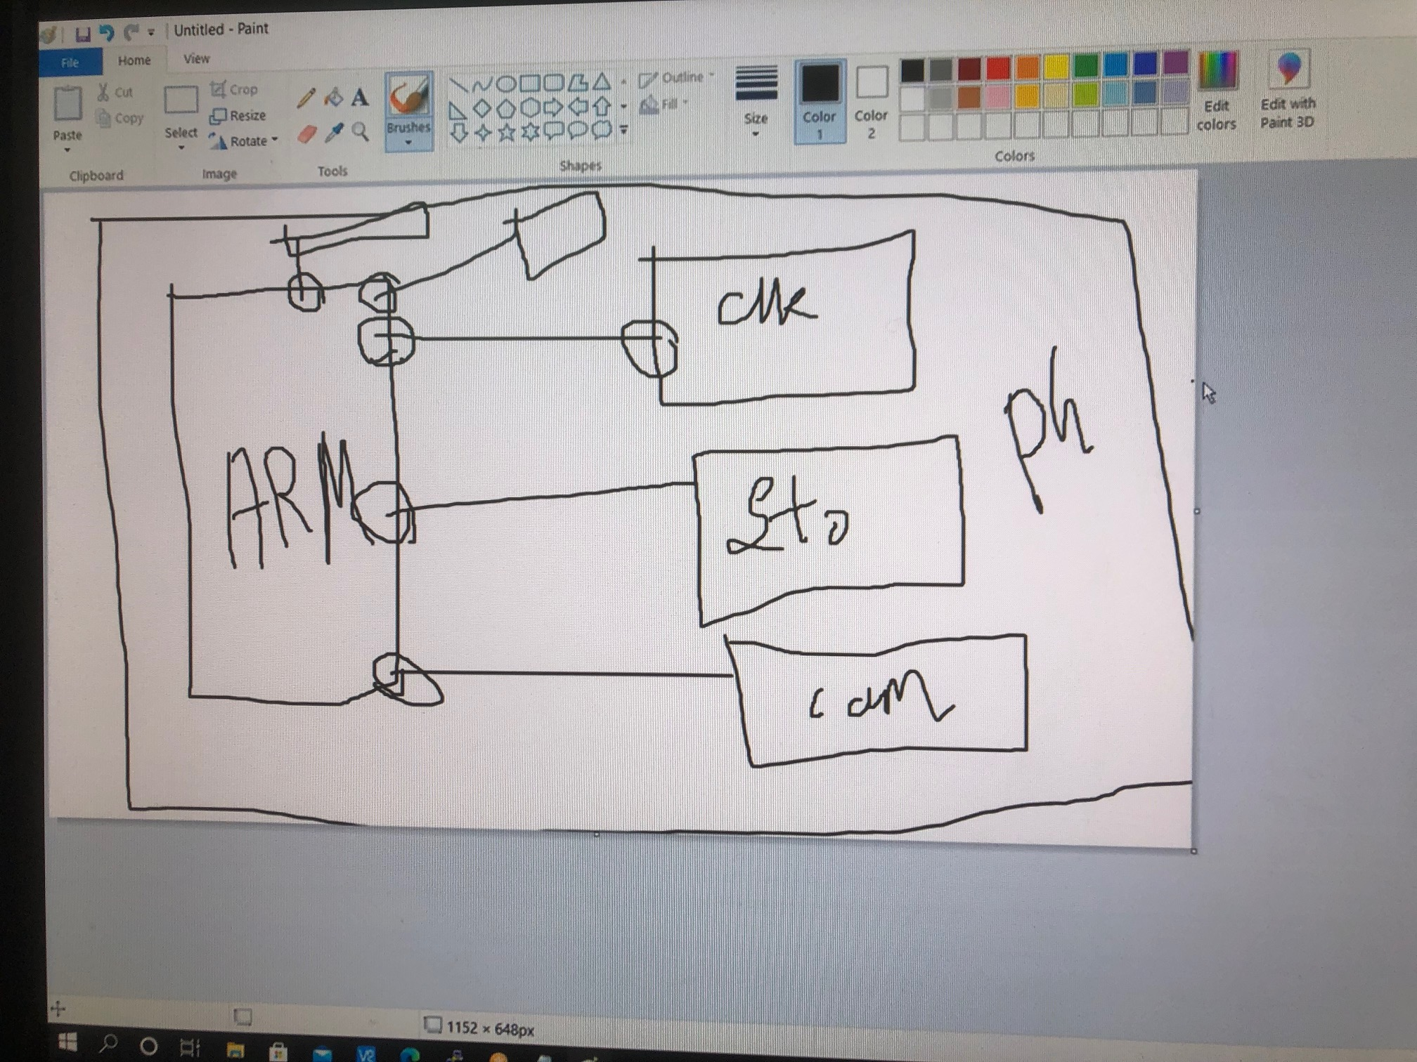

Slide 3
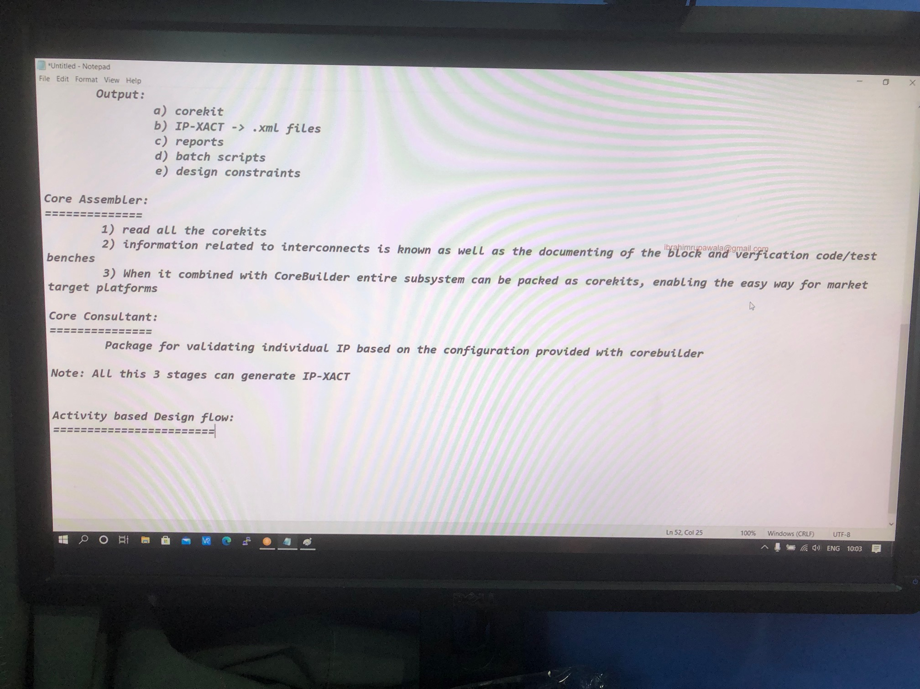

Slide 4
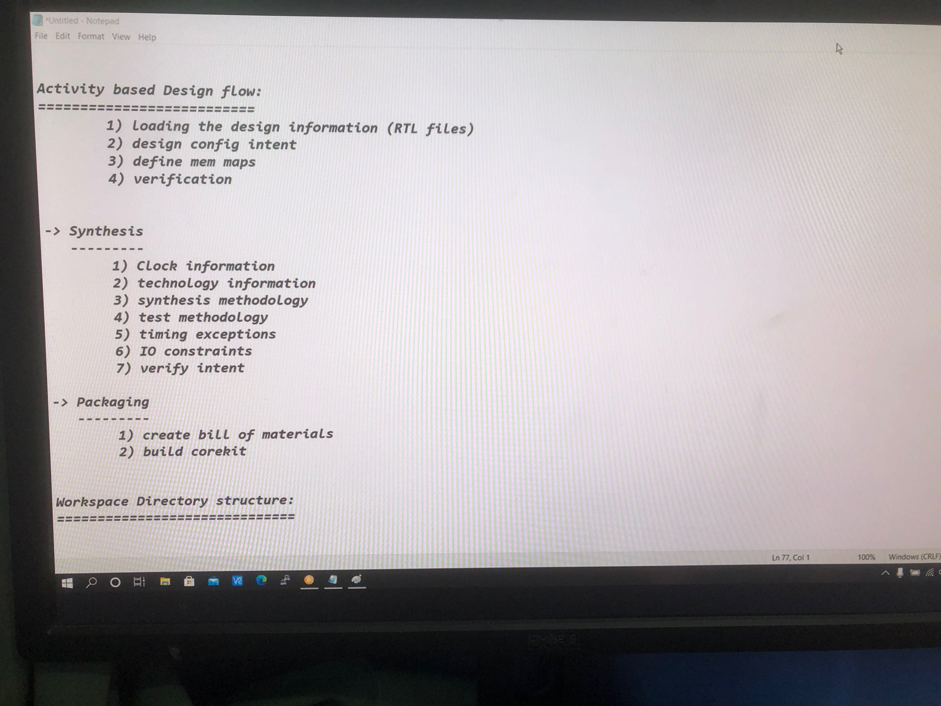

Slide 5
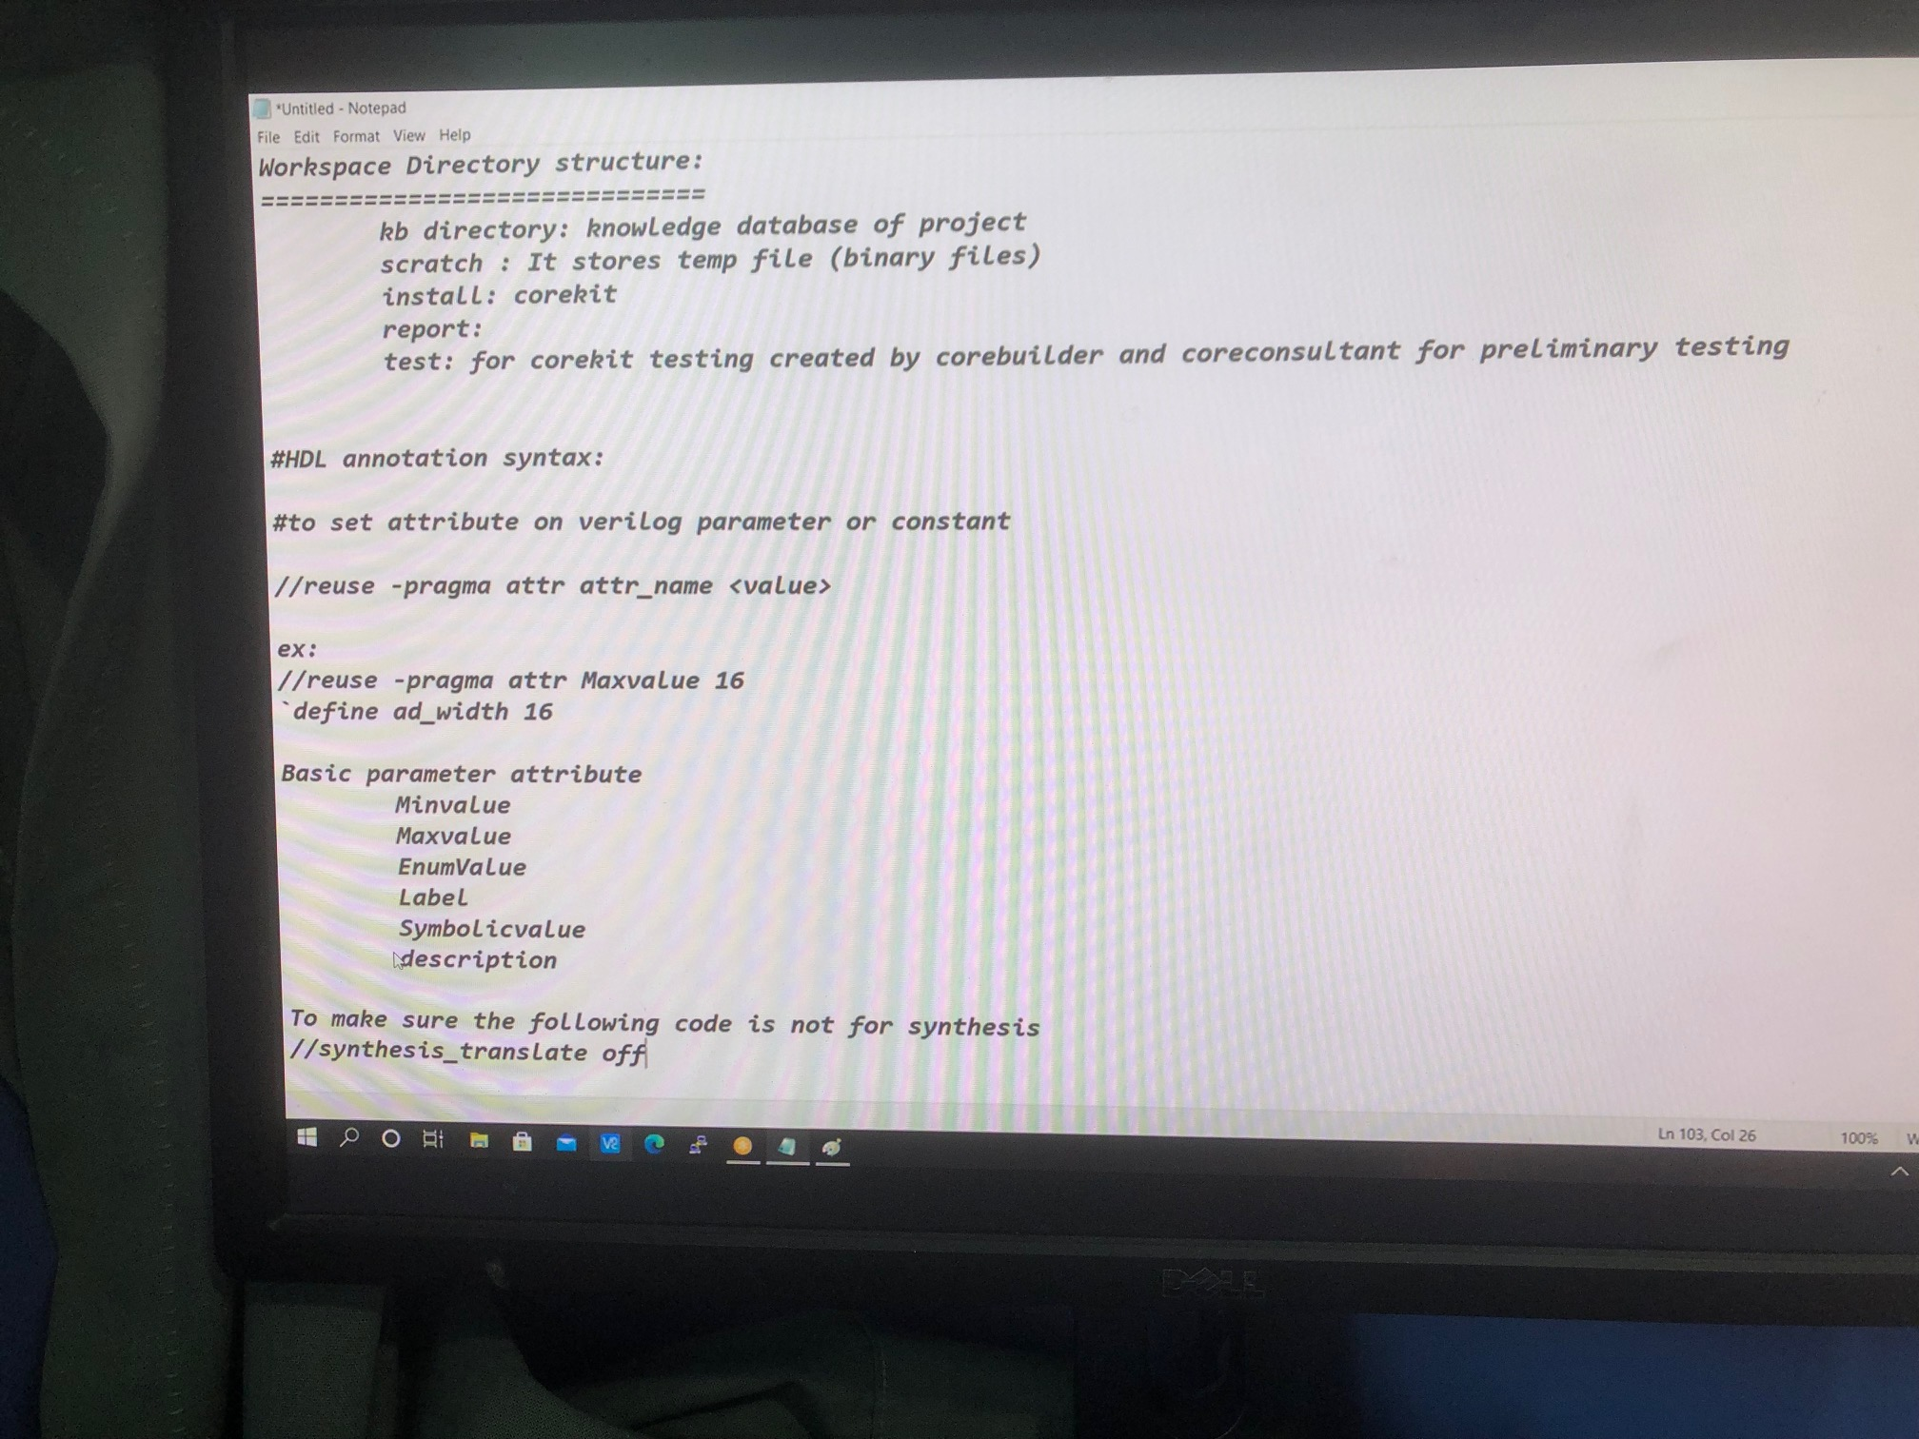

Slide 6
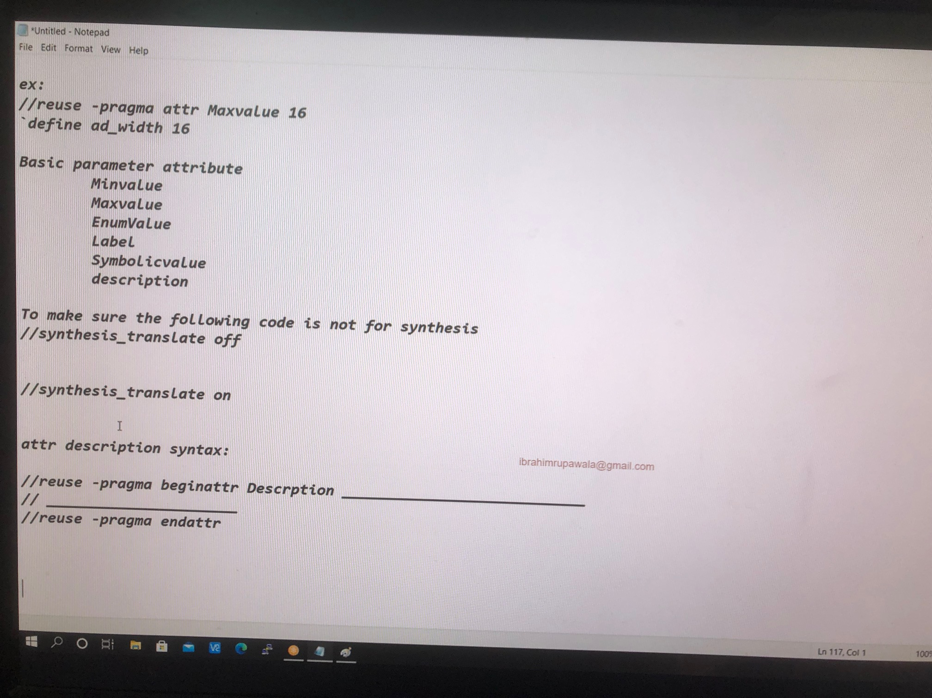

Slide 7
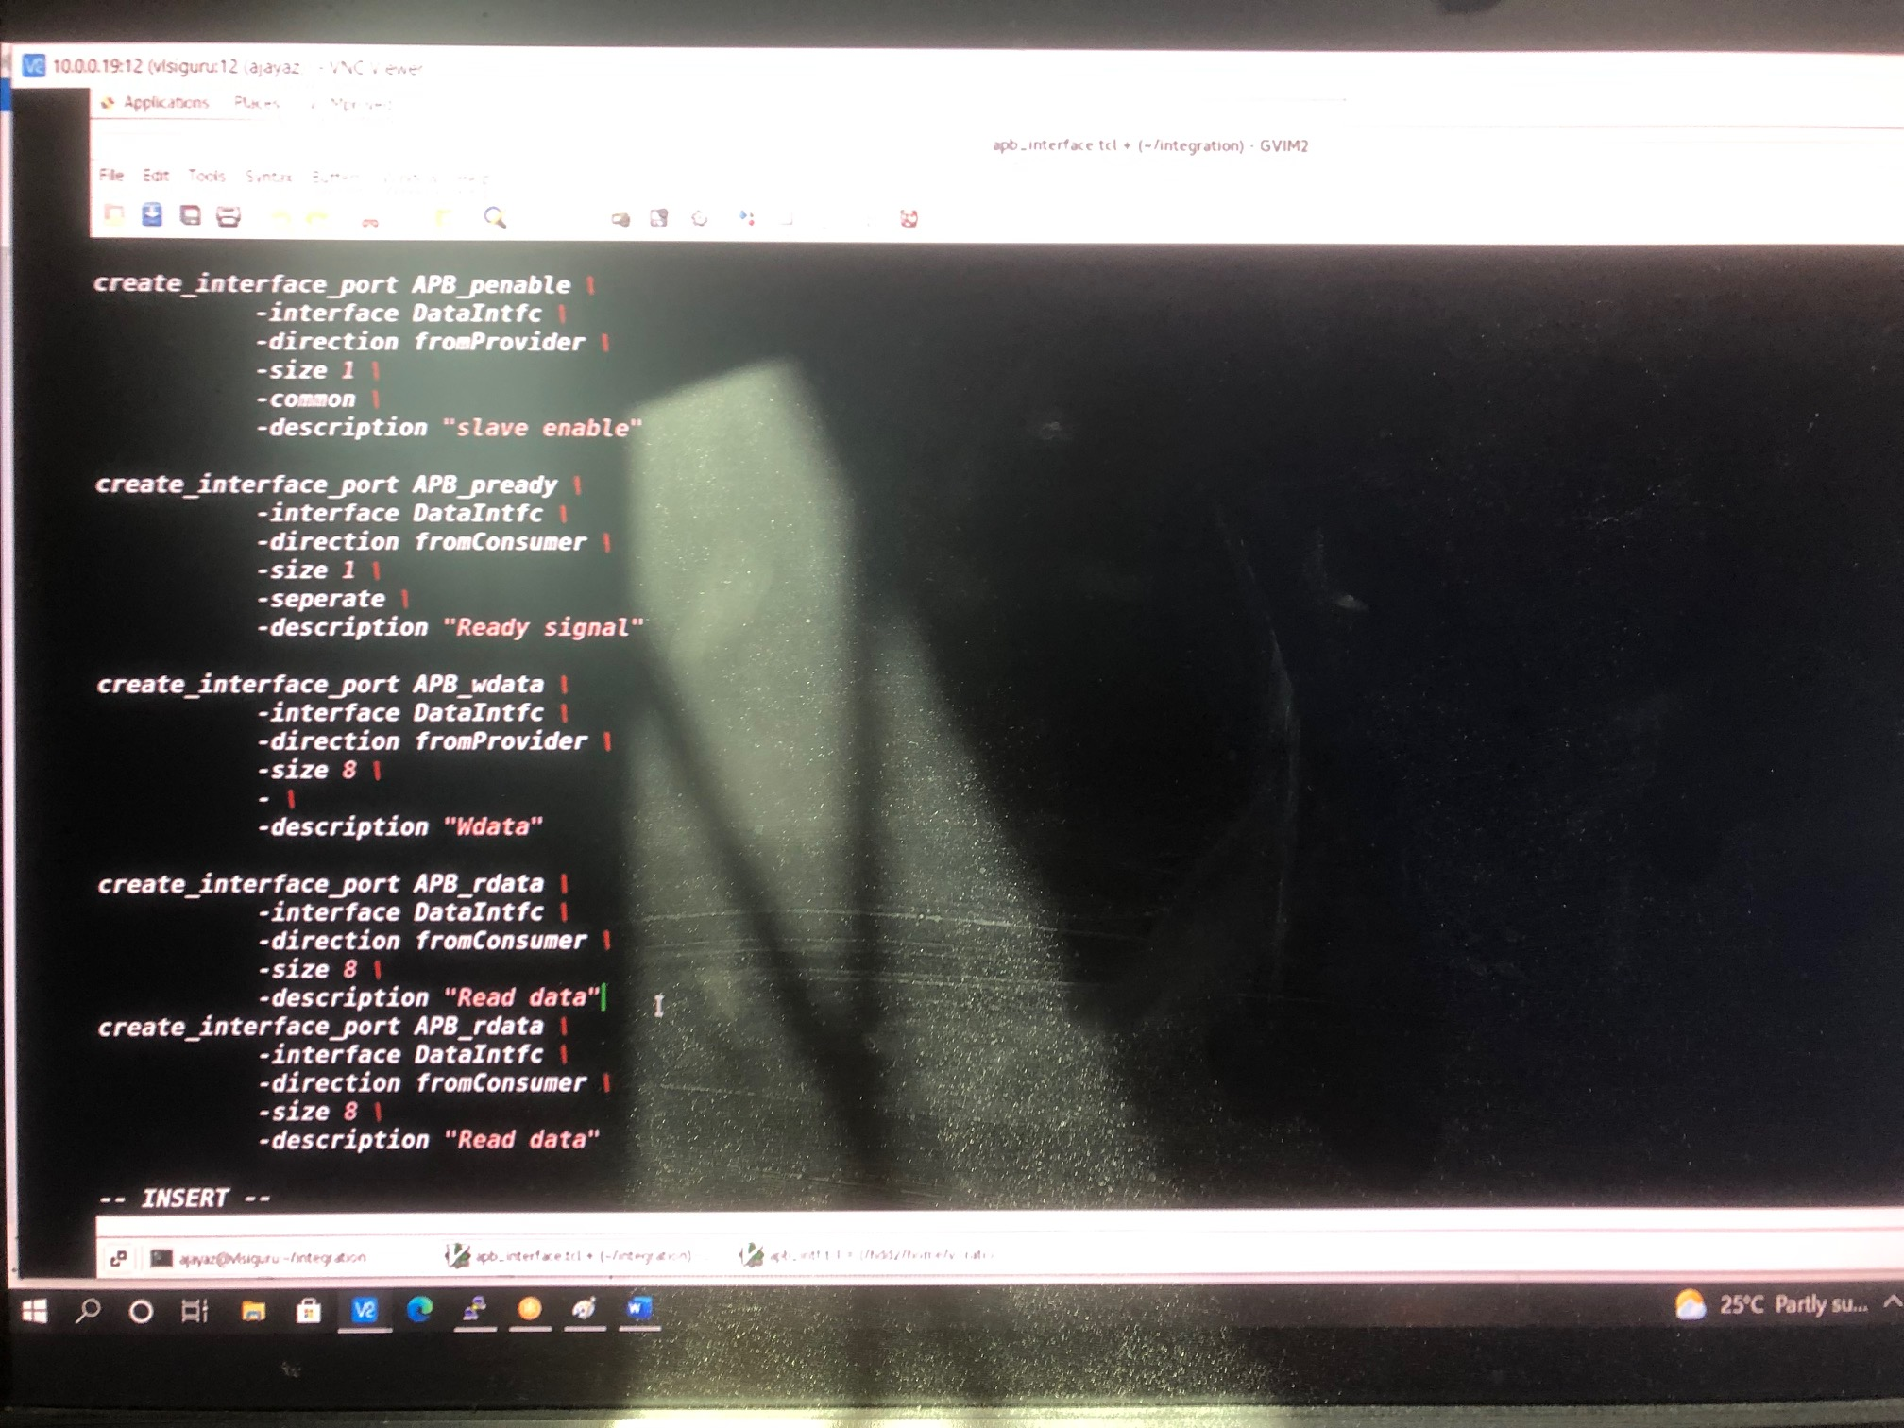

Slide 8
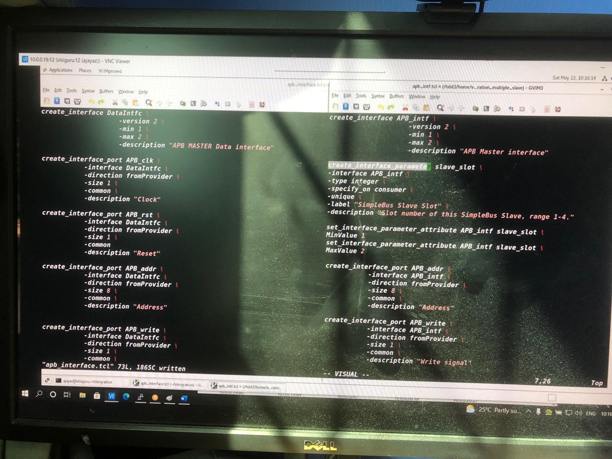

Slide 9
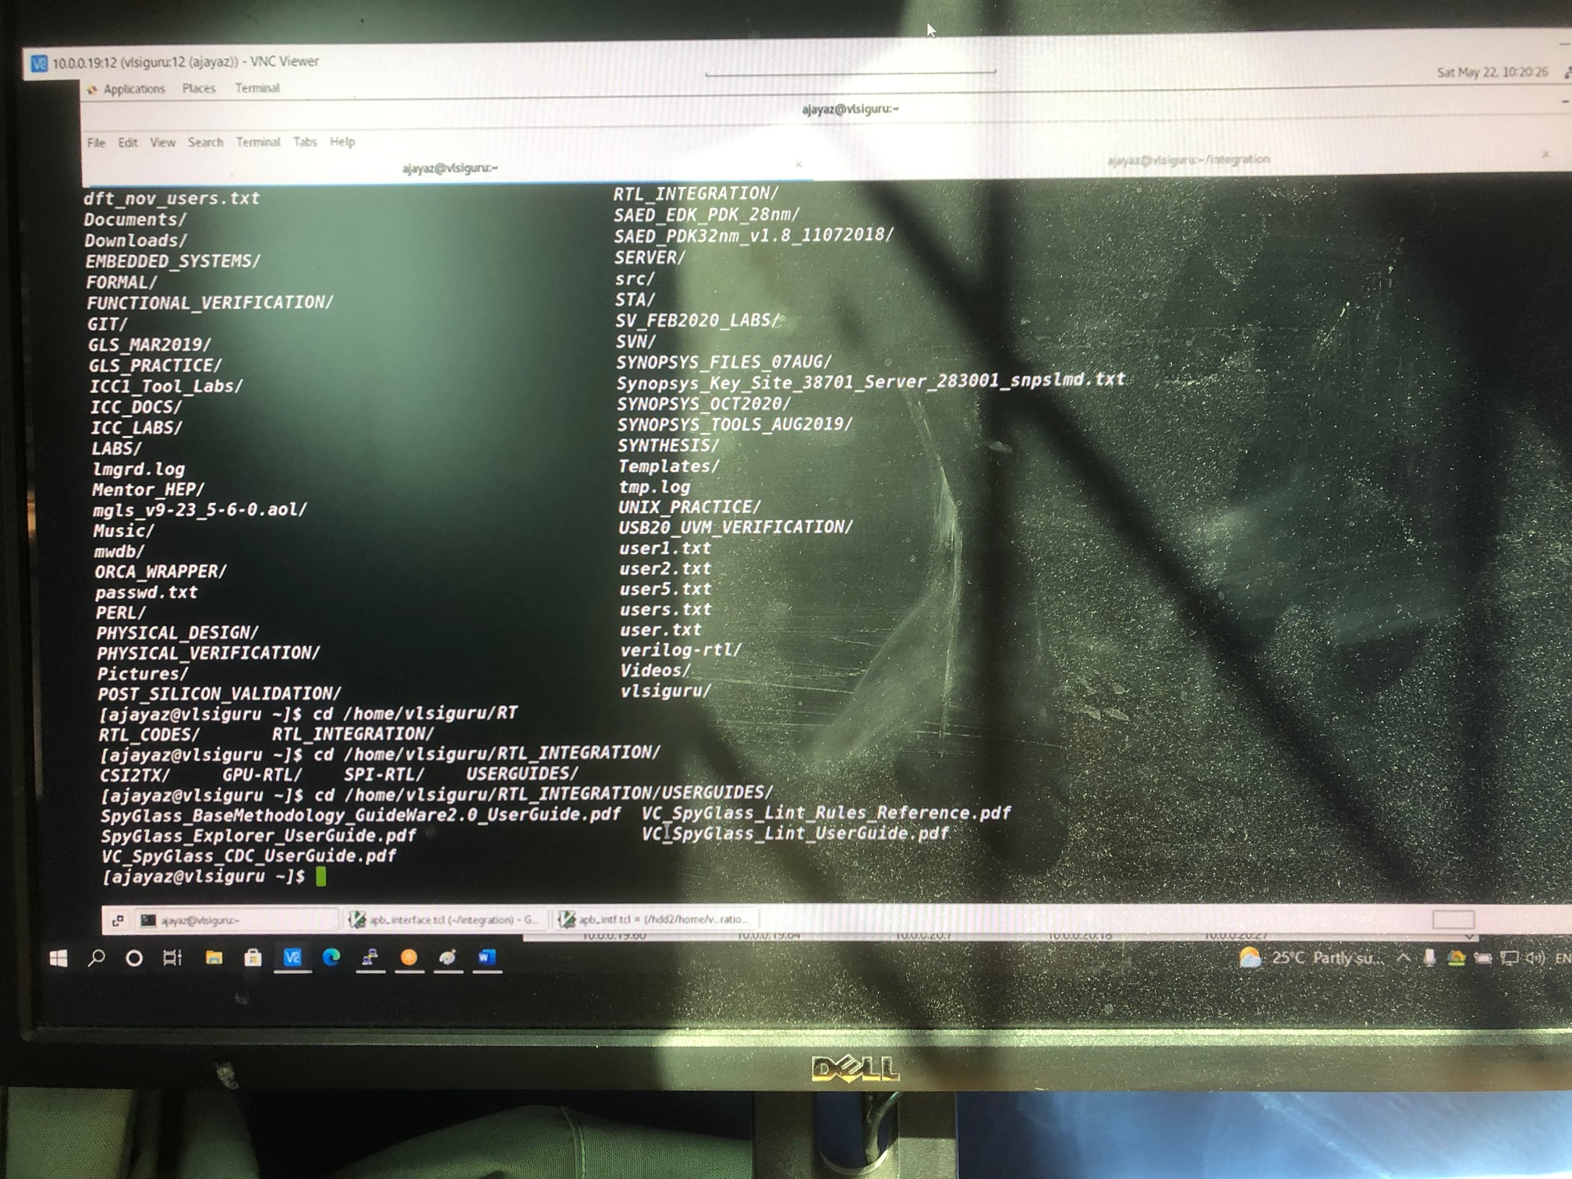

Slide 10
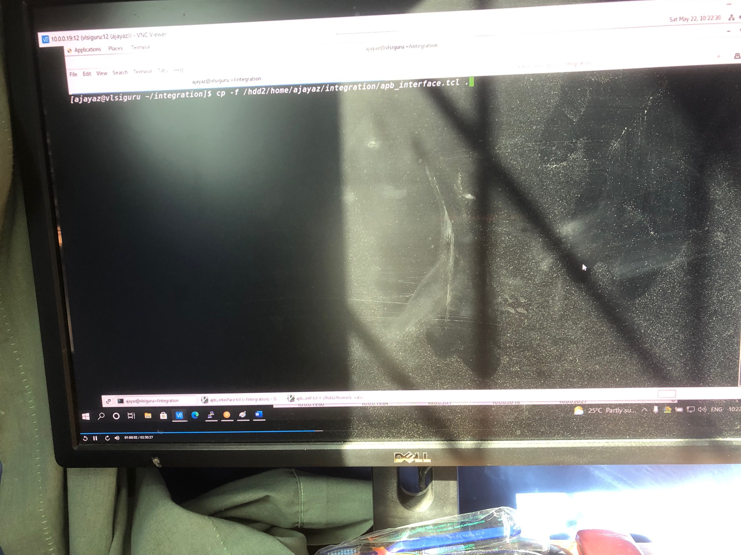

Slide 11
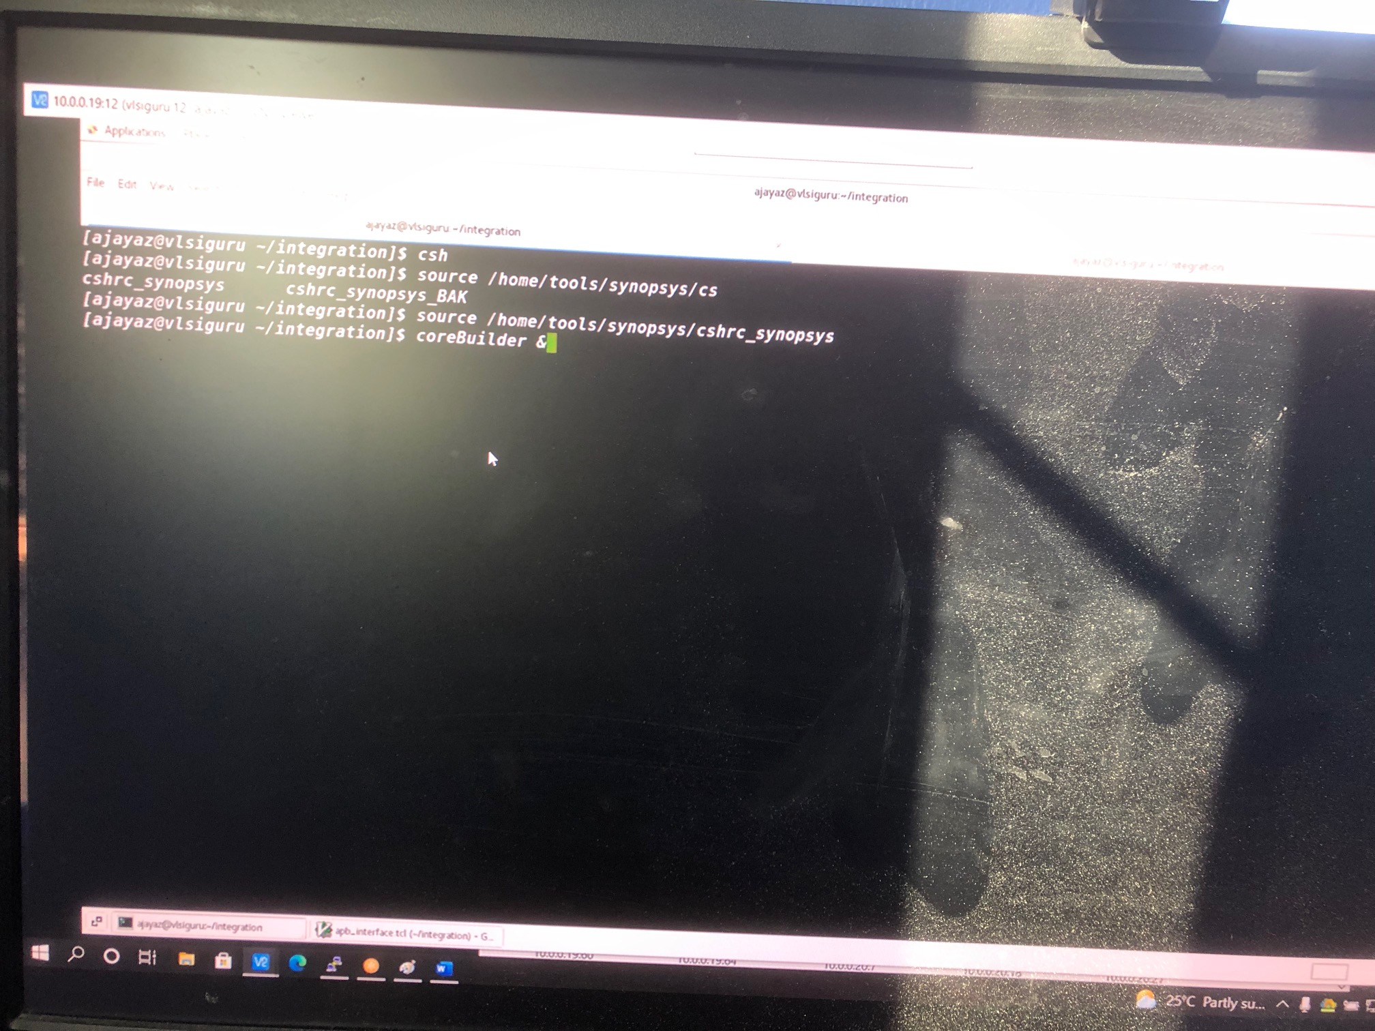

Slide 12
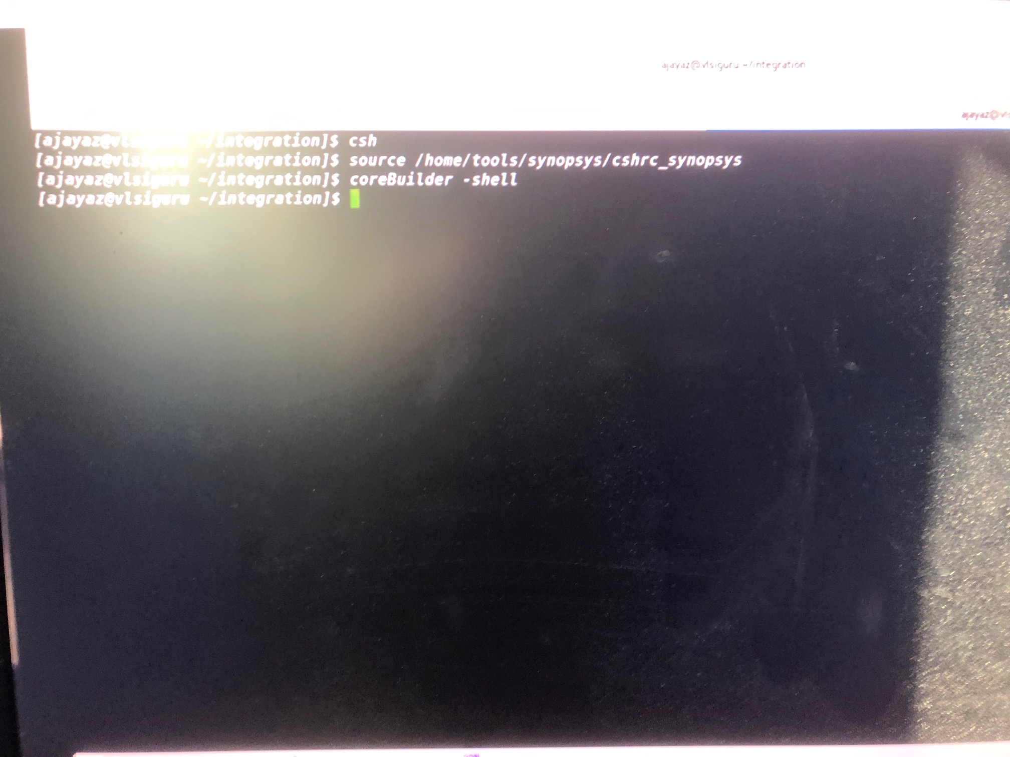

Slide 13
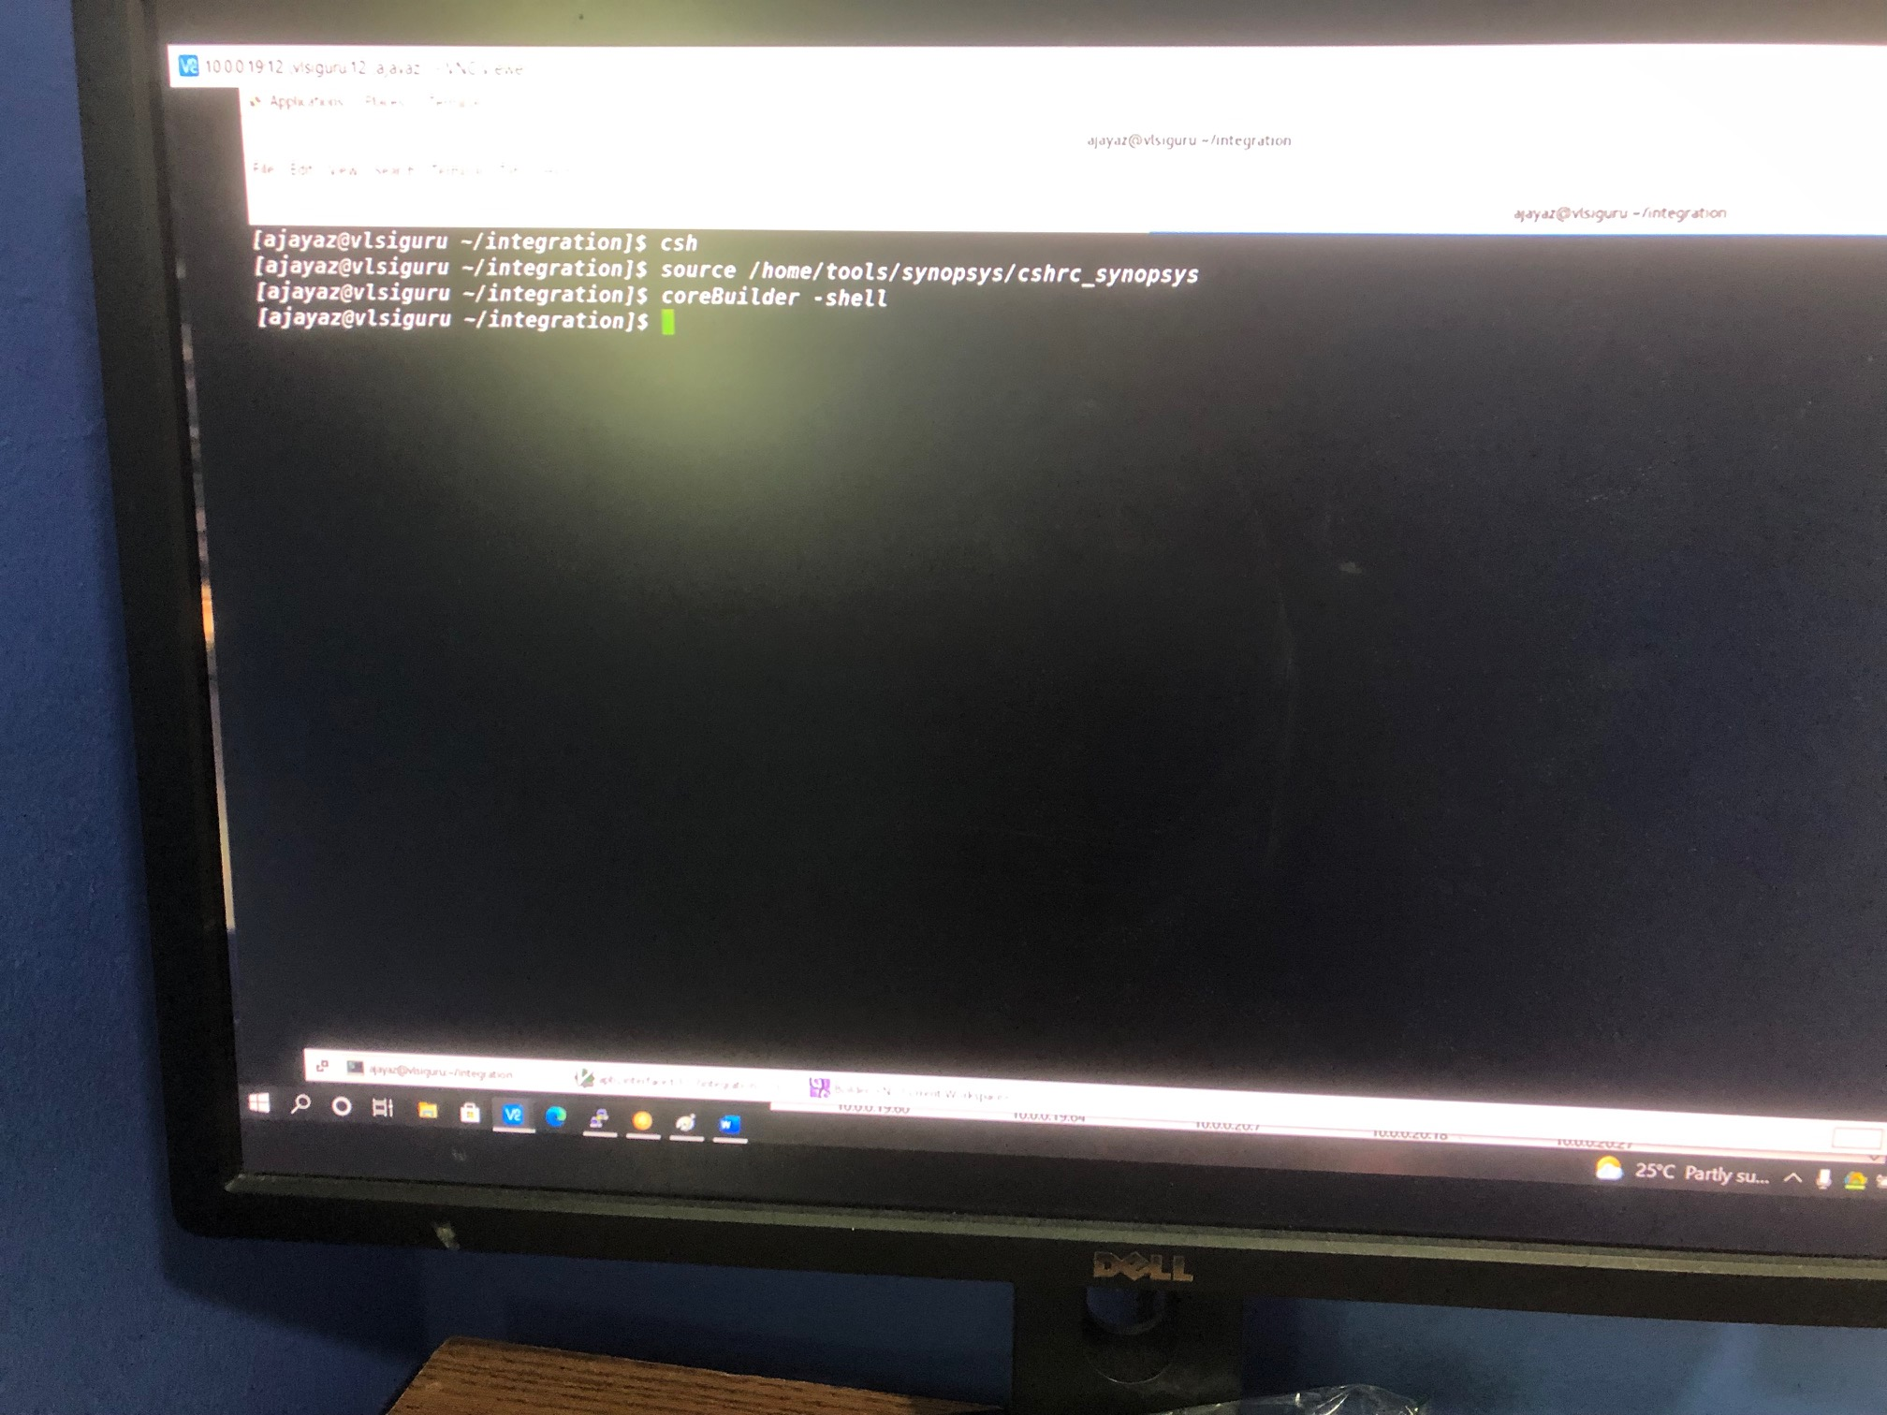

Slide 14
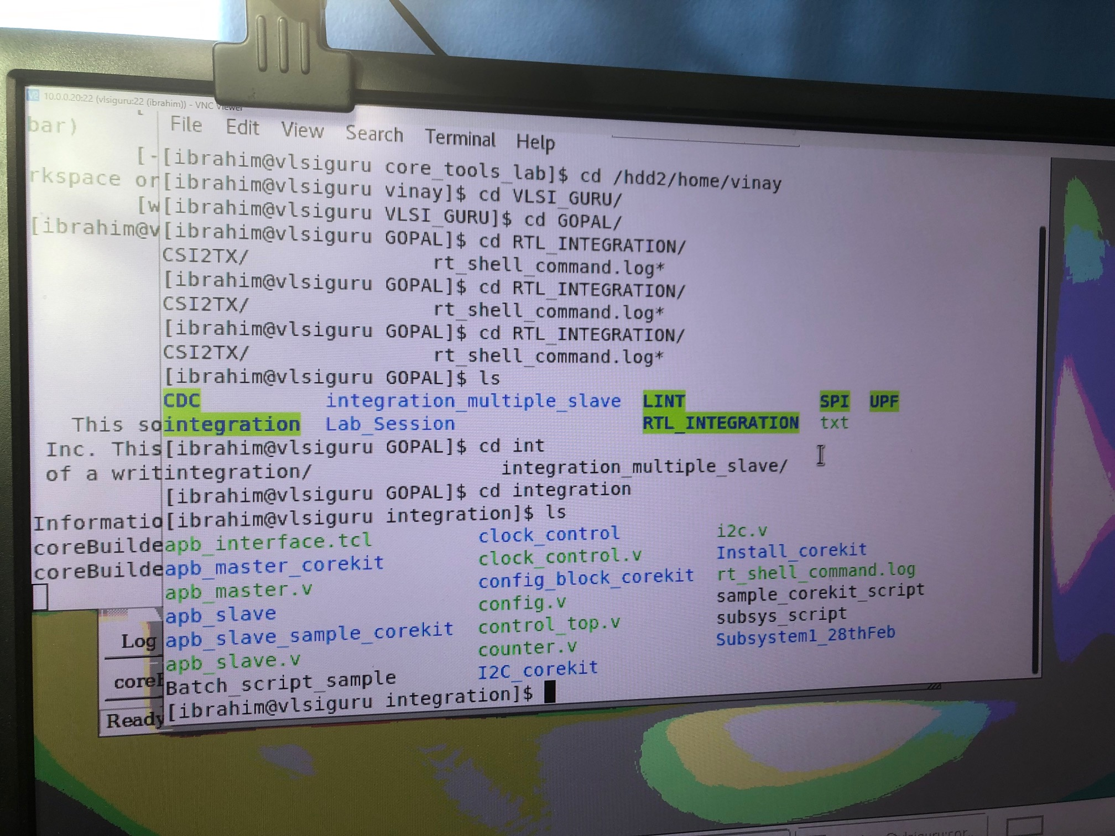

Slide 15
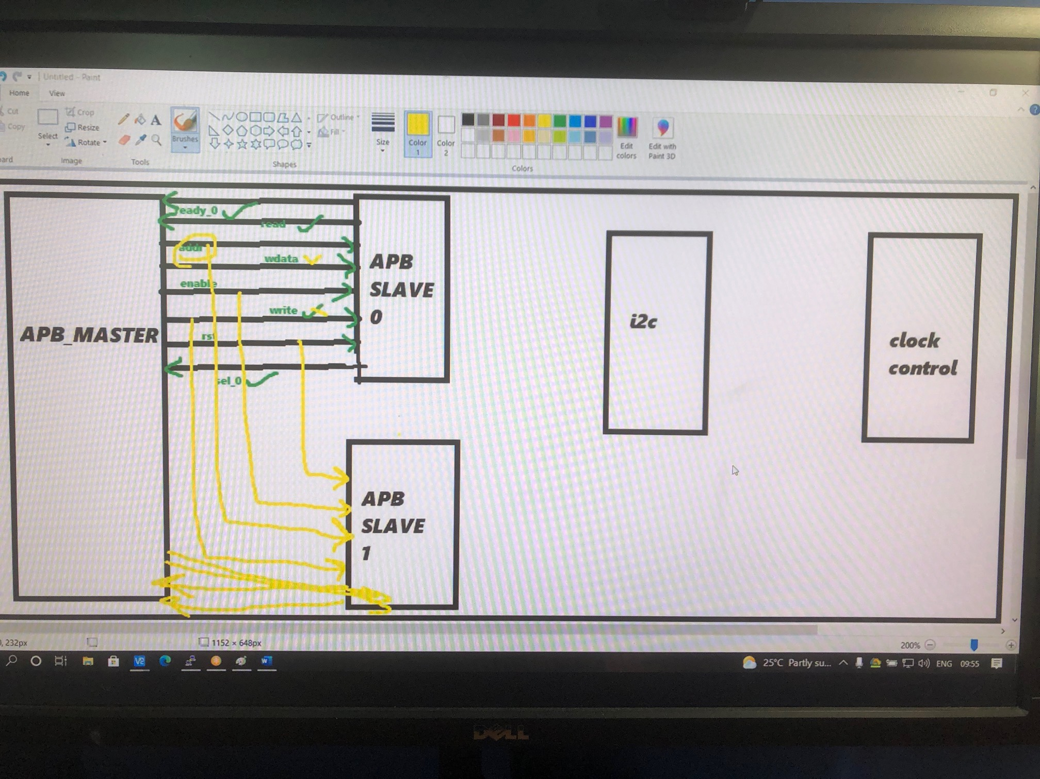

Slide 16
Core builder - Converts RTL netlist to core kits formats which are used by tools to integrate design, there are also parameters which are needed to be taken care of
Core assembler - Converts the entire design built from corekits to generate a complete required netlist
After the netlist is generated all the linting, CDC and UPF should be performed again
Integrated command tcl provides all details regarding the input/output net size of various components, etc
reports generated by core builders can be UPF, synthesis, timing reports but we do not generally use them because they are not perfect
synthesis methodology - how to perf synthesis, steps, modifying some apps variables, which extra algo to use, which methodology to use physical aware / logical aware synthesis
test methodology - which tests where I want to test it
Packaging is the output stage from this particular intent
1) create bill of materials - extract all the information list in synthesis, all the information provided in synthesis will be optimized and throw the outputs like what are the RC values, area, etc

